Slide 1
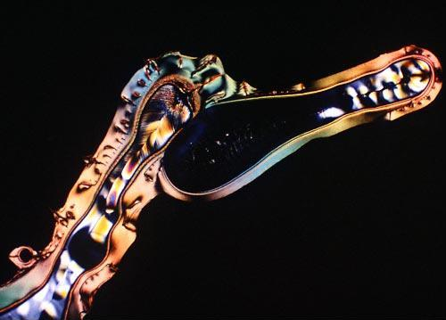
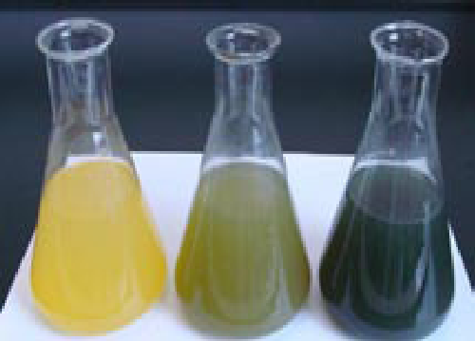
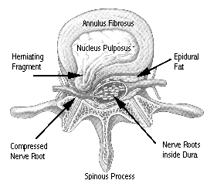
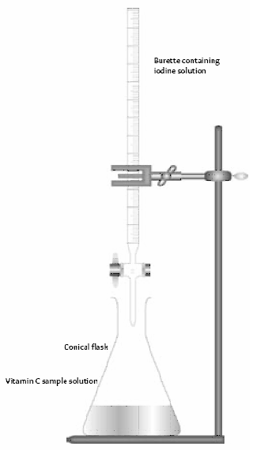

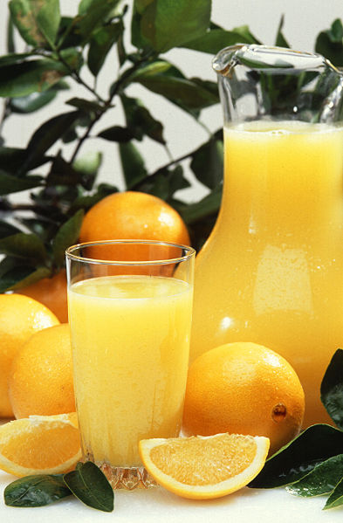
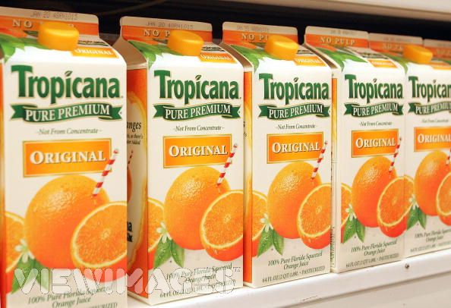
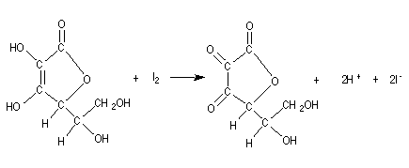
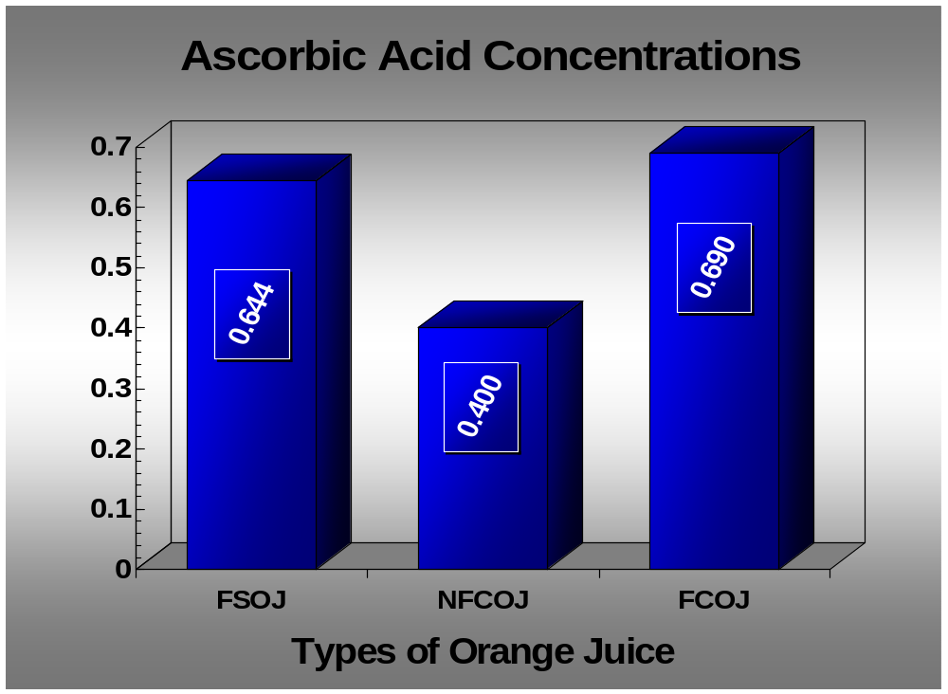
Statement of Problem
Determining Ascorbic Acid Concentrations by Redox Titrations with Iodine
Results
Vitamin C is not produced naturally within the human body as it is in most other mammals. Recognizing this fact, in what ways can one obtain his/her daily values of Vitamin C? Which orange juice contains the greatest concentration of Vitamin C among fresh-squeezed orange juice, premium orange juice, and orange juice from frozen concentrate? Furthermore, what could possibly lead to the damaging of ascorbic acid molecules?
The amount of iodine solution (1:10) needed to oxidize the ascorbic acid in each of the 3 types of orange juices, freshly squeezed orange juice (FSOJ), premium orange juice (not-from-concentrate, NFCOJ), and orange juice from frozen concentrate (FCOJ) was discovered by using 3 trials for each type of orange juice.
In the 3 trials for FSOJ, the measured amounts of iodine solution that were needed to complete the titrations were 6.90 mL, 6.70 mL, and 6.70 mL. Thus, the average of the 3 trials was calculated to be 6.76 mL.
In the 3 trials for NFCOJ, the measured amounts of iodine solution that were needed to complete the titrations were 4.30 mL, 4.10 mL, and 4.20 mL. Accordingly, the average was calculated to be 4.20 mL.
Lastly, the 3 trials for FCOJ had results of 7.30 mL, 7.10 mL, and 7.20 mL for the measured amounts of iodine solution needed to oxidize all ascorbic acid in the orange juice. The average of the 3 trials for the titration of FCOJ was therefore 7.20 mL.
The data collected from the 9 trials in total establishes that FCOJ had the greatest concentration of ascorbic acid, followed by FSOJ and NFCOJ (Table 1), but to investigate more in detail of how much ascorbic acid was in every mL of each type of juice, the reference created by the titration of the dissolved Vitamin C tablet came into play.
The titration of the dissolved Vitamin C tablet (1 mg/mL) was crucial in creating a ratio as to compare the titrations of the orange juices with a standard. To find the amount of iodine solution (1:10) that is needed to oxidize a 1mg/mL Vitamin C solution, 3 trials were conducted to ensure accuracy. The results of the 3 trials were 10.5 mL for each.
Arranging a ratio with each type of orange juice, calculations were performed and the conclusion came to be that there are 0.644 mg/mL of ascorbic acid in FSOJ, 0.400 mg/mL of ascorbic acid in NFCOJ, and 0.690 mg/mL of ascorbic acid in FCOJ (Graph 1). So, to summarize the results of this experiment, it was concluded that FCOJ had the greatest concentration of ascorbic acid, followed by FSOJ and NFCOJ.
Introduction
Methods and Materials
The human body naturally calls for a constant nourishment of various vitamins and minerals to function properly. One of the most vital vitamins the human body needs to survive and flourish is Vitamin C, or ascorbic acid. Most mammals have the ability to produce their own vitamin C; humans, who do not have such ability, must incorporate it into their diet.
Vitamin C serves as an antioxidant, protecting molecules in the body from free radicals and reactive oxygen species. Moreover, as humans transfer fat to energy in the body to perform physically, Vitamin C participates in the synthesis of the molecule carnitine, making this conversion possible. Vitamin C also plays an important role in the synthesis of collagen, an essential building block in the formation of blood vessels, tendons, ligaments, and bone.
Not only does Vitamin C affect the body physically though; it proves to be essential to one’s mental health. The production of norepinephrine, a neurotransmitter known to affect mood, requires Vitamin C.
Knowing that the intake of Vitamin C is fundamental to one’s health, the question is where to find it. Vitamin C is abundant in many different fruits and vegetables, including berries, citrus fruits, guavas, tomatoes, melons, and papayas. Commonly known to contain Vitamin C is orange juice, a fruit drink extracted from the wringing of oranges. Orange juice can be acquired in many different ways, as one will notice if they visit a local market.
With freshly squeezed orange juice, premium orange juice, and orange juice from concentrate readily available, oxidation-reduction reactions can be performed using iodine. The oxidation-reduction reaction, in this case, will consist of the ascorbic acid molecule losing electrons, which are gained by the iodine molecule. This combination makes the ascorbic acid molecule oxidized because it loses electrons and makes the iodine molecule reduced because it accepts electrons.
To know when the iodine-ascorbic acid reaction is complete, an indicator is added to each of the three solutions, or juices. Iodine will always choose to react with ascorbic acid over starch, the indicator in these solutions, which makes this titration technique possible. The reaction of soluble starch with iodine will turn a solution a blue-black color, signifying there is no ascorbic acid left. Therefore, discovering which orange juice has the greatest concentration of Vitamin C will be in direct, positive correlation with the amount of iodine added to each solution.
To determine the concentration of ascorbic acid in freshly squeezed orange juice (FSOJ), premium orange juice (not-from-concentrate, NFCOJ), and orange juice from frozen concentrate (FCOJ), the characteristics of a redox reaction had to be manipulated. A redox reaction is the epigrammatic way to say that a reduction, a gain of electrons, and an oxidation, a loss of electrons, both take place in harmonization. In this case, the atom or molecule that loses electrons is ascorbic acid (oxidization), and the atom or molecule that accepts electrons is iodine (reduction). The iodine was diluted to generate a 1:10 ratio, or in other words, a solution was created that consisted of 1 mL of iodine for every 9 mL of distilled water. The indicator in this iodine and ascorbic acid titration was soluble starch (0.5% solution). Recognizing that iodine always chooses to react with ascorbic acid over starch, a distinct color change (blue-black) brought about by iodine and starch reaction signaled the endpoint of the titration.
Vitamin C deficiency can cause disc herniations in spinal cords. In the diagram to the right, the Annulus Fibrosus is a tough material while the Nucleus Pulposus is a softer, cushioning material. With a chronic Vitamin C deficiency, the Annulus Fibrosus can lose its tough exterior and acquire a hole through which the Nucleus Pulposus can slip out, causing a disc herniation. Picture by Vitamin C Deficiency.
Three trials with each type of orange juice (FSOJ, NFCOJ, and FCOJ) were executed carefully and cautiously. The standards of NFCOJ (Tropicana Original) and FCOJ (Minute-Maid Original) were purchased without pulp, but the freshly squeezed orange juice required a filtering process through cheesecloth before any data collection could take place. After extracting juice from multiple oranges by using a juicer and then filtering out pulp, a graduated cylinder was used to measure 20 mL of the freshly squeezed juice. The 20 mL of freshly squeezed juice was poured into a 50 mL Erlenmeyer flask and 10 drops of starch indicator solution was added using an eyedropper.
In the diagram, Iodine was added to Ascorbic acid using starch as an indicator. The flask on the very left in the diagram is what the titration looked like while ascorbic acid was still present in the solution. The flask on the very right shows what the solution looked like if too much Iodine was added. The flask in the middle of the diagram is the endpoint of the titration and when the data was recorded. Picture by University of Canterbury.
This procedure was repeated 2 more times for FSOJ to collect a total of 3 trials. The same method was used to find how much iodine solution was needed to oxidize NFCOJ and FCOJ.
Discussion and Conclusions
To standardize and formulate a reference for the iodine titrations, a Vitamin C standard solution (1 mg/mL) was created using a Vitamin C tablet. A 500 mg Vitamin C tablet was crushed and dissolved in 500 mL of water to achieve the 1mg/mL balance. The series of steps that was used to determine the concentration of ascorbic acid in FSOJ, NFCOJ, and FCOJ was also used to generate 3 trials for this “tablet” solution, so it could be determined how much iodine solution it takes to oxidize a known amount of Vitamin C.
To calculate the amount of Vitamin C that was in FSOJ, NFCOJ, and FCOJ, a ratio was used. The ratio was the average amount of iodine solution (in mL) that it took to titrate 20 mL of 1 mg/mL Vitamin C standard solution, under 20 mg, to the average amount of iodine solution (in mL) that it took to titrate 20 mL of any given orange juice, under x. Then x was solved for, in mg. For example, this was the calculation for the amount of vitamin C in NFCOJ: 20 mg/10.5 mL = x/4.2 mL = 8.0 mg.
My hypothesis was that home-made fresh-squeezed orange juice, followed by premium juice and juice from frozen concentrate, would contain the greatest concentration of ascorbic acid. The results of my experiment were unforeseen and proved my hypothesis incorrect. The collection of data revealed that the greatest concentration of ascorbic acid was in FCOJ (0.690 mg/mL), followed by FSOJ (0.644 mg/mL) and then NFCOJ (0.400 mg/mL). FCOJ and FSOJ were relatively close in the amounts of Vitamin C that they contained, but NFCOJ contained a far less concentration of this vital vitamin.
As one can see by the data in this experiment, FCOJ had the most ascorbic acid, but with almost an equal concentration of ascorbic acid was FSOJ. FCOJ, when initially canned in factories, goes through a process called deaeration, in which air molecules are removed from the orange juice to prevent the loss of ascorbic acid. This explains why FCOJ would contain the greatest concentration of Vitamin C: oxygen, which will over time decrease ascorbic acid levels, is removed from cans in factories to preserve Vitamin C levels in the product. Not until the cans are opened and made into orange juice is the frozen concentrate exposed to oxygen, creating less time for the oxygen to decrease the concentration of ascorbic acid in the orange juice and more time for the body to absorb it through consumption.
This also explains why the FSOJ had quite a large concentration of Vitamin C. The FSOJ was tested just 16 hours after it was made the night before, and as soon as the orange juice was extracted from various oranges, the juice was poured into a nearly airtight jar, in which it was consequently prevented from a severe loss of ascorbic acid. The conclusion that NFCOJ had low levels of ascorbic acid made sense because the orange juice was purchased from a store, in which it had probably been sitting on a shelf for quite some time.
Sitting on a shelf in a grocery store, NFCOJ is not only vulnerable to more vitamin loss by air molecules within its own packaging, but the warmer temperature of the grocery store shelves compared to a refrigerator can cause vitamin loss, as vitamin loss is accelerated at higher storage temperatures.
The results of this experiment agree with previously published works, as most projects that involved finding concentrations of ascorbic acid in orange juice came to show that FCOJ always contained the greatest amount of the Vitamin C. FSOJ usually has less of an ascorbic acid concentration than it did in this experiment, but this was most likely due to inadvertently protecting it from vitamin loss due to oxygen.
Recording the amount of iodine solution that was in the buret was done first. Then, the spring clamp of the buret was released so as to add iodine solution drop by drop until no ascorbic acid remained in the Erlenmeyer flask. Once no ascorbic acid remained in the 20 mL sample of freshly squeezed orange juice, the iodine solution would begin to react with the starch indicator, producing a distinct color change signaling the end of the titration. The final amount of iodine that was left in the buret was recorded, and the difference between the initial and final volumes was taken to find the amount of iodine solution that was needed to oxidize the Vitamin C, or ascorbic acid.
Oranges are offered in the fresh fruit section of the market, premium not-from-concentrate orange juice is available in the refrigerated section, and juice made from frozen concentrate is on hand in the frozen section. Recognizing what type of orange juice contains the most Vitamin C would be most beneficial to one concerned about their health in this area. Studying the concentration of Vitamin C in different juices is possible through experimentation, using a titration of the vitamin by iodine.
The flask on the left of every picture in the diagram shows what the endpoint of the titration with the Vitamin C tablet looks like. The picture on the very left needs more iodine to complete the titration, while the picture on the very right has had too much iodine added. Picture by University of Canterbury.
Picture by Vitamin C and Citrus Juices.
Iodine was added drop by drop for each titration. Picture by University of Canterbury.
With extended periods of time, air molecules within the packaging of premium orange juice cause Vitamin C loss. Fluctuations in temperature during the manufacturing process may also cause Vitamin C loss. Picture by Vitamin C.
Data
When a redox titration is complete between ascorbic acid and iodine, their molar amounts are equal. The iodine is reduced by the ascorbic acid to form iodide. Picture by Helmenstine.
 | Trial 1 (mL) | Trial 2 (mL) | Trial 3 (mL) | Average (mL)
FSOJ | 6.90 | 6.70 | 6.70 | 6.77
NFCOJ | 4.30 | 4.10 | 4.20 | 4.20
FCOJ | 7.30 | 7.10 | 7.20 | 7.20
Vitamin C Tablet | 10.50 | 10.50 | 10.50 | 10.50
Concentration (mg/mL)
Hypothesis
TABLE 1. Iodine Needed to Oxidize Ascorbic Acid.
Future Research
My objective was to determine which orange juice had the greatest concentration of ascorbic acid, or Vitamin C. My hypothesis is that home-made fresh-squeezed orange juice, followed by premium juice and juice from frozen concentrate, will contain the greatest concentration of ascorbic acid.
The three trials for each type of orange juice and the Vitamin C tablet are given, along with the averages.
GRAPH 1.
The ascorbic acid concentration of each orange juice in mg/mL is given.
To improve the accuracy of results in this type of experiment, iodate solution should be used because it is more stable and will produce more exact data. For future research, it would be interesting to test the vitamin levels in different types of fruits and vegetables and compare those with the vitamin levels in FDA approved multivitamins. What is the best way to obtain your daily dose of vitamins?

